Slide 1

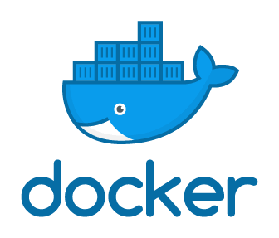
Introduction To Docker
A little bit of background with plenty of hands-on
Notes:
// TODO

Slide 2
If you want hands-on practice…
Create a Docker Hub Account
https://hub.docker.com/signup
Download and install Docker Desktop
https://www.docker.com/products/docker-desktop
Connect to the ATC VPN
https://atc-support.apps.wwtatc.com/vpn_access
Download this presentation from WWT’s internal GitHub
https://github.wwt.com/hullt/docker-foundations
Install a code editor
https://code.visualstudio.com/Download
Wait a few minutes while we get through a Docker overview
Notes:
// TODO

Slide 3
Part I
Docker Background
Notes:
// TODO

Slide 4
Why Does Does Docker Matter?
Helps use fewer resources than virtual machines
Creates portability between different operating systems and clouds
Easy to spin up and spin down, rapidly
Translation – Docker helps organizations move faster, be more agile, and save money
Notes:
// TODO

Slide 5
What is Docker?
“Docker is a set of platform as a service products that use OS-level virtualization to deliver software in packages called containers. Containers are isolated from one another and bundle their own software, libraries and configuration files; they can communicate with each other through well-defined channels.”
https://en.wikipedia.org/wiki/Docker_%28software%29
Okay…then what in the heck is a container?
Notes:
// TODO

Slide 6
What is Container?
“OS-level virtualization refers to an operating system paradigm in which the kernel allows the existence of multiple isolated user space instances called containersprograms inside of containers can only see contents and devices assigned to the container.”
https://en.wikipedia.org/wiki/OS-level_virtualization
Confused? Let’s compare virtual machines and containers…
Notes:
// TODO

Slide 7
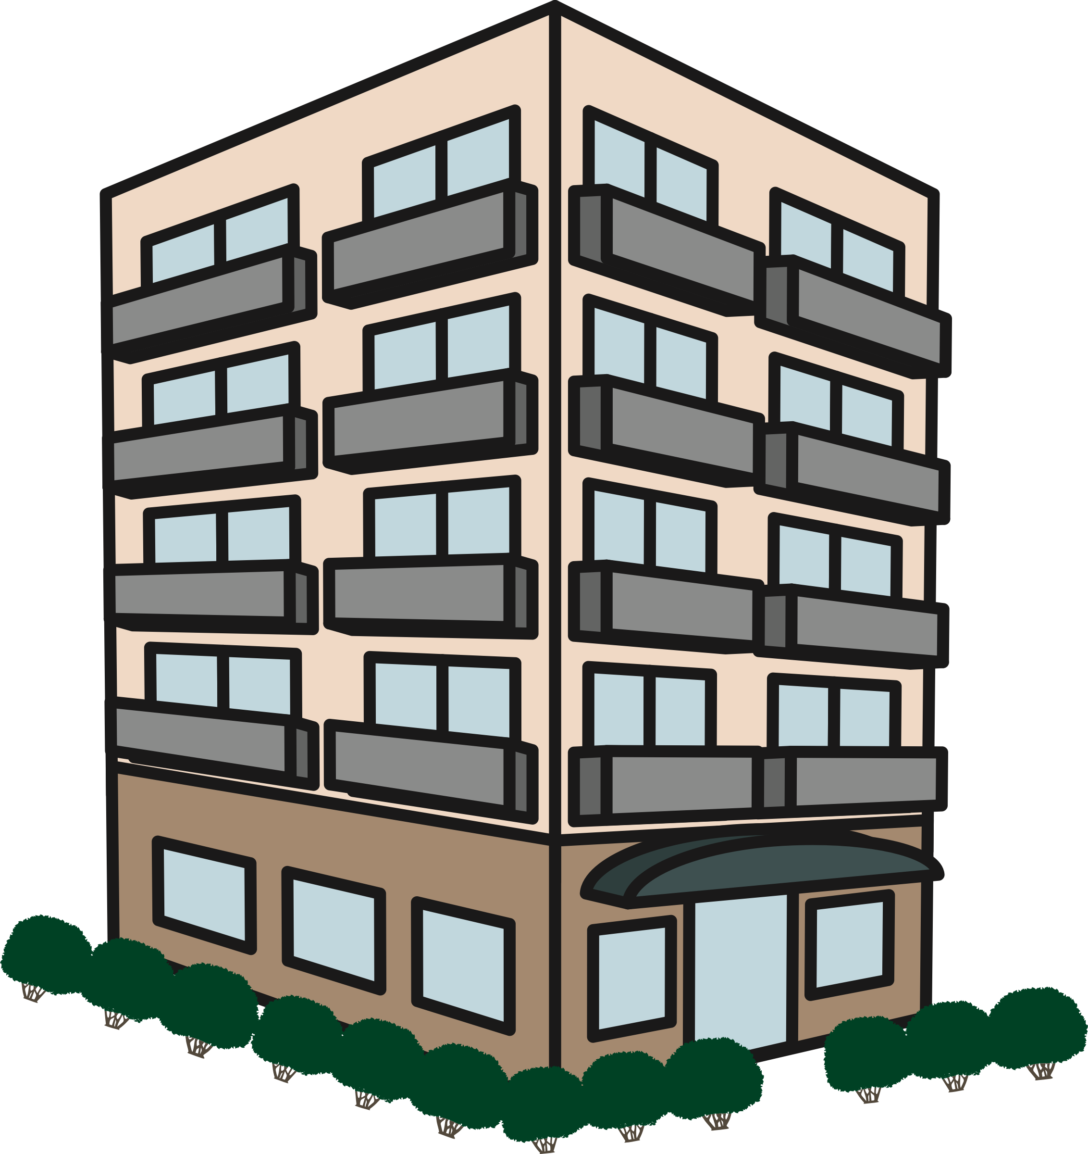

Comparing Virtual Machines and Containers
Virtual Machines ≈ Houses
Containers ≈ Apartments
If all you need is an apartment,
why buy a house?
Fully self-contained
Safeguarded from unwanted guests
Dedicated utilities
Dedicated rooms – kitchen, dining room, family room, living room, etc.
Isolated living spaces
Safeguarded from unwanted guests
Shared utilities
Shared rooms – kitchen/dining room, family/living room etc.)
Notes:
// TODO

Slide 8
Virtual Machine and Container Architecture
Type 1 Virtualization
Type 2 Virtualization
Containerization
Virtual Machines
Containers
App
App
App
App
App
App
Virtual Machines
App
App
App
Bin/Libs
Bin/Libs
Bin/Libs
Bin/Libs
Bin/Libs
Bin/Libs
Bin/Libs
Bin/Libs
Bin/Libs
OS
OS
OS
App
App
App
OS
OS
OS
Bin/Libs
Bin/Libs
Bin/Libs
Hypervisor (Type 2)
Docker Daemon
Hypervisor (Type 1)
Host OS
Host OS
Bare Metal
Bare Metal
Bare Metal
Notes:
// TODO

Slide 9
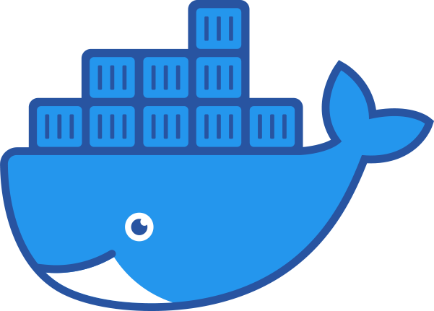



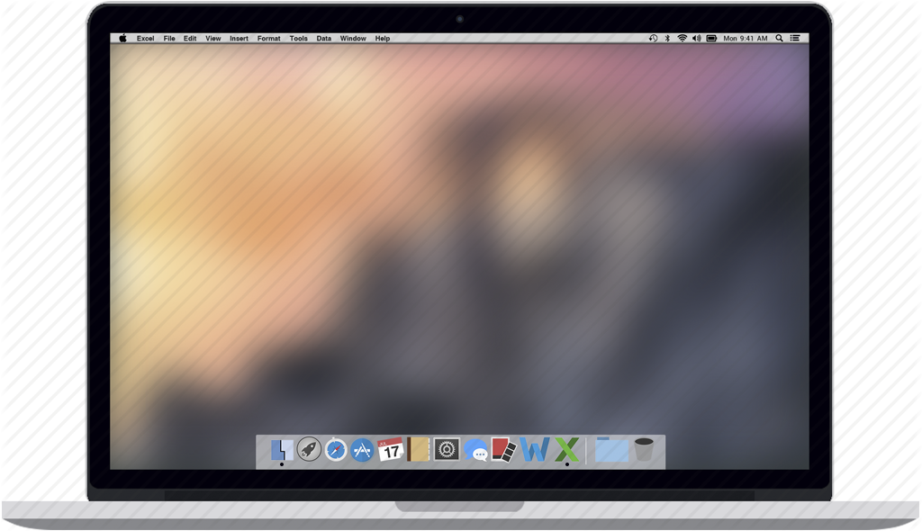



Wins for Docker
Standardized developer environments
Distributed, especially multi-cloud, environments
Micro-services architectures
Cross-OS tool usage
Service C
Service C
for x in range(3):
print(x)
Service B
Service B
Service A
Service A
Notes:
Standardized developer environments – standardize development tools, platforms, dependencies, etc.
Distributed, especially multi-cloud – containers are highly portable without requiring re-platforming
Micro-services architectures – isolate processes/services, each component of an application; if one service fails, the application can still mostly function
Cross-OS tool usage – download/install/run a Linux tool on Windows or macOS platforms, within a Docker container

Slide 10
Docker Engine Overview
Client
containers
docker CLI
networks
manages
REST API
manages
Server
images
data volumes
docker daemon
Notes:
// TODO

Slide 11
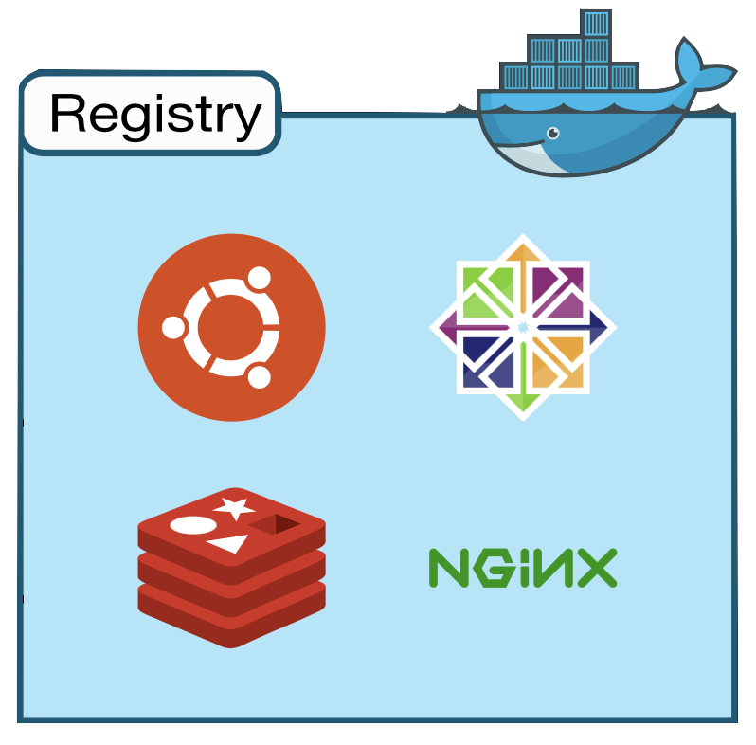
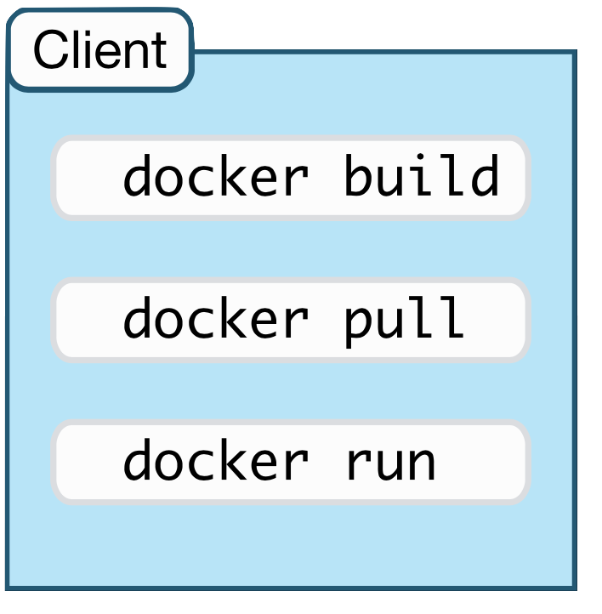
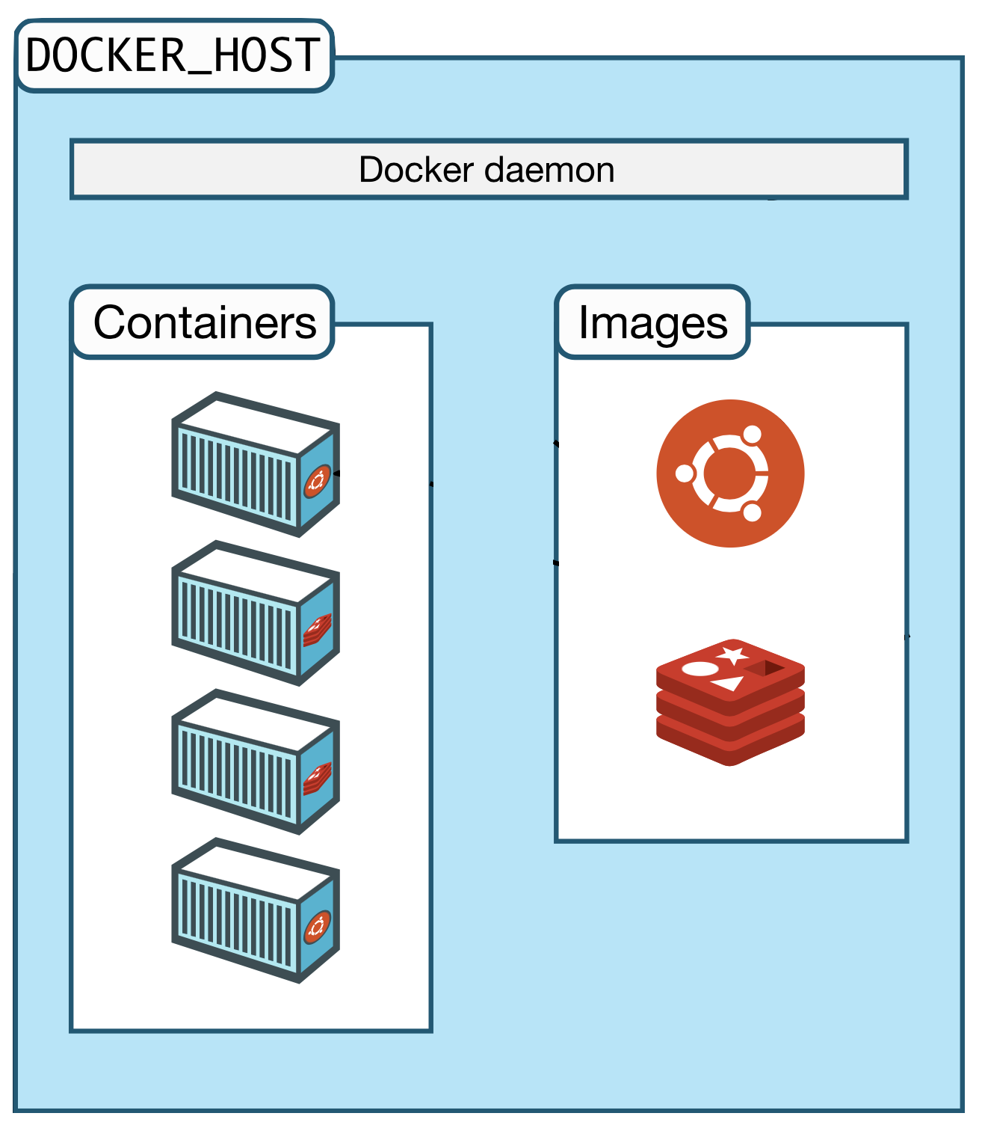
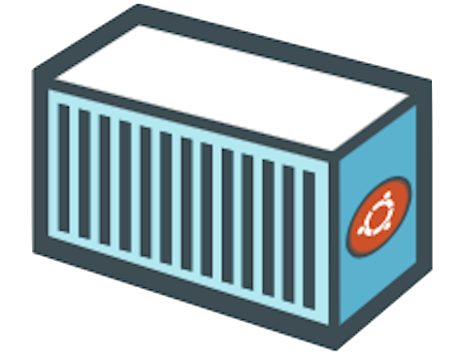

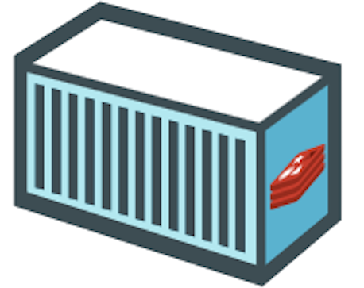
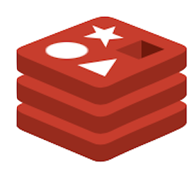
The Docker Architecture
Notes:
// TODO

Slide 12
Part II
Docker Verify Your Installation
Notes:
// TODO

Slide 13
Sign In to Docker Desktop
Open/start Docker Desktop
Log on with your Docker Hub account
krismiller
Notes:
// TODO

Slide 14
Verify Your Docker Installation
Open your preferred terminal (bash, PowerShell, zsh, etc.)
Enter the commands:
docker --version
docker info
docker run hello-world
Notes:
// TODO

Slide 15
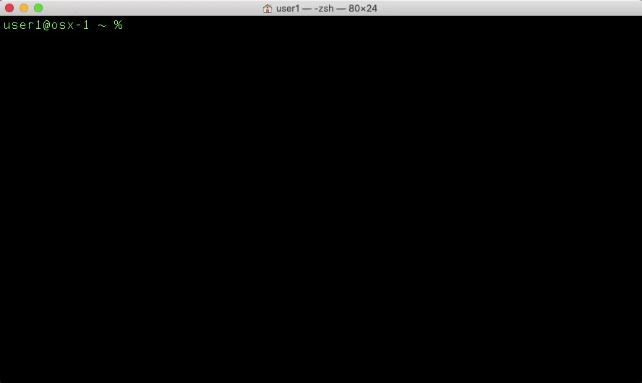
Release Year
Release Month
Notes:
// TODO

Slide 16
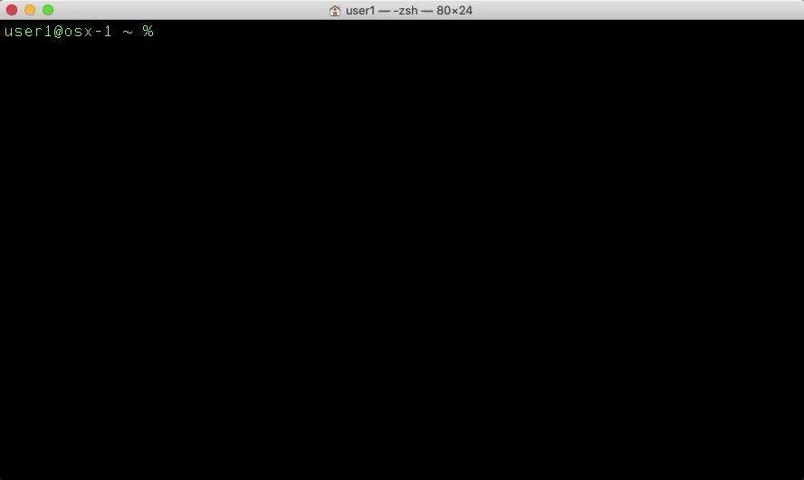
Notes:
// TODO

Slide 17
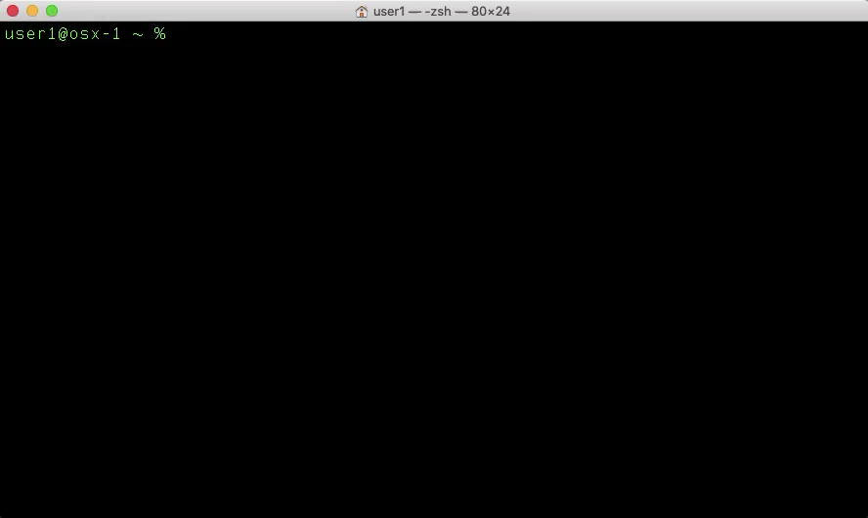
Notes:
// TODO

Slide 18
Part III
Create a Docker Image
Notes:
// TODO

Slide 19
Docker Images
Immutable templates for Docker Containers
Built using a Dockerfile with all required binaries, packages, etc.
List your Docker Images with the terminal command:
docker image ls
Notes:
// TODO

Slide 20
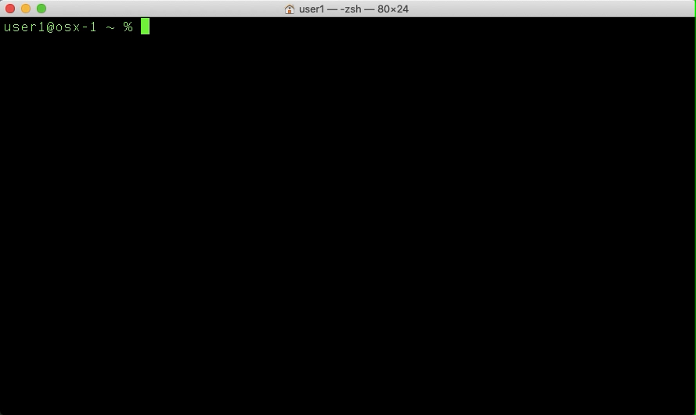
Notes:
// TODO

Slide 21
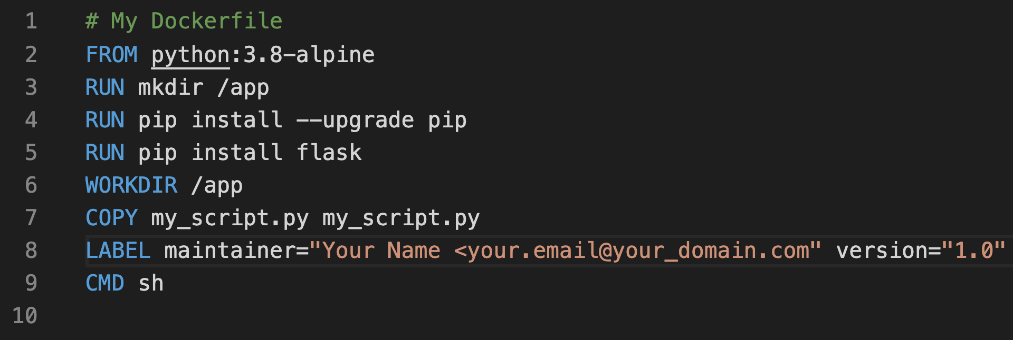
The Dockerfile
The Docker Image blueprint, read from top to bottom
A text file named “Dockerfile”
Comprised of UPPERCASE instructions
Each instruction represents a layer of the image
Notes:
// TODO

Slide 22


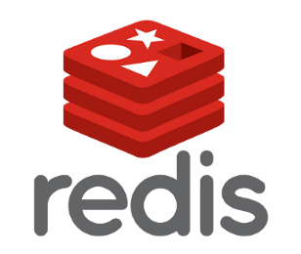
The Dockerfile
Dockerfile
FROM python:3.8-alpine
RUN pip install flask
RUN apk add redis
CMD sh
Notes:
// TODO

Slide 23
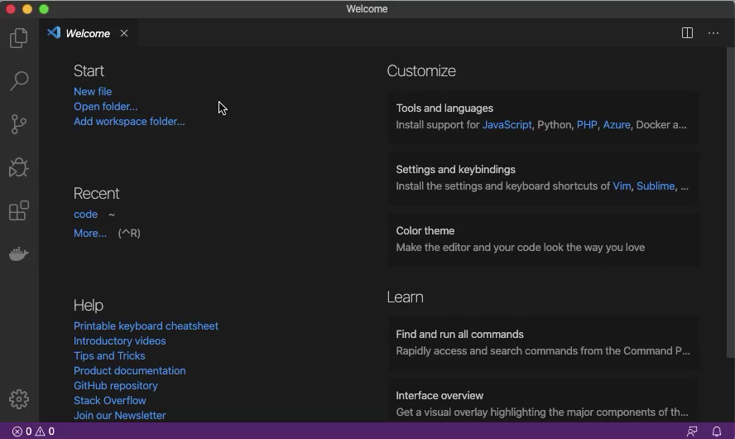
Notes:
// TODO

Slide 24
The FROM Instruction
Always the first instruction, specifies base OS image
Base image index available on https://hub.docker.com
Formatted using tags
FROM python:3.8-alpine
FROM instruction
Alpine Linux OS
Python official image
Python version 3.8
https://hub.docker.com/_/python
Notes:
// TODO

Slide 25
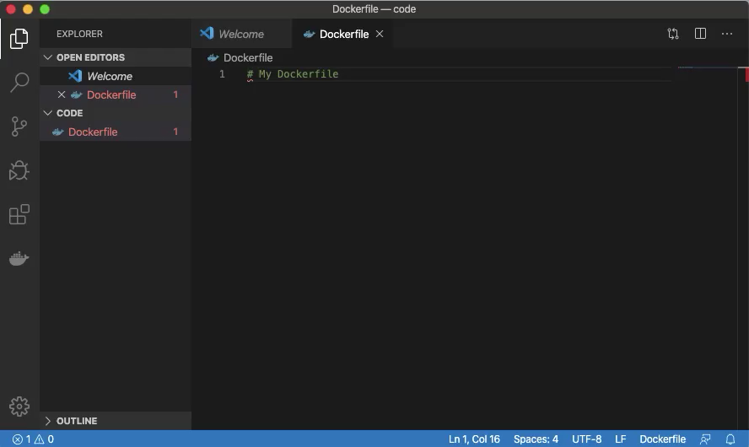
Notes:
// TODO

Slide 26
The RUN Instruction
Runs any command/script available in the OS
Create directories (mkdir), install packages (pip, apk, yum, etc.), run scripts, etc.
RUN mkdir /app
RUN instruction
Shell command
RUN pip install --upgrade pip
RUN pip install flask
RUN apk add redis
Notes:
// TODO

Slide 27
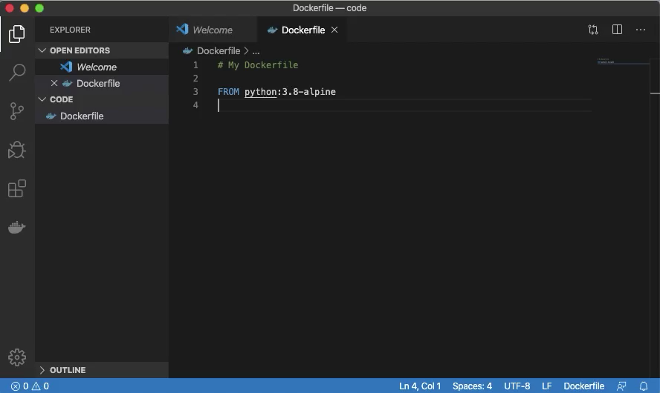
Notes:
// TODO

Slide 28
The WORKDIR Instruction
Sets the working directory for other instructions (RUN, COPY, etc.)
Accepts absolute or relative paths (/home/folder1, folder1)
Will be the result of the pwd command in the container
WORKDIR /app
WORKDIR instruction
Working directory
WORKDIR bin
WORKDIR resources
bash$
pwd
returns
/app/bin/resources
Notes:
// TODO

Slide 29
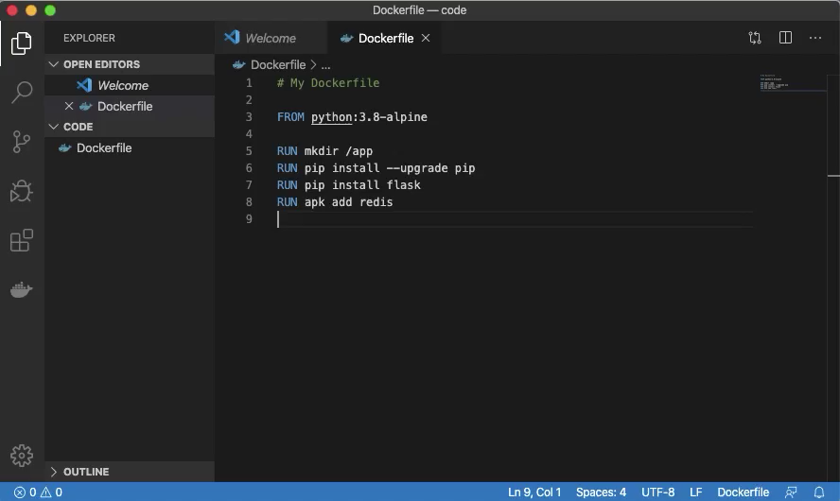
Notes:
// TODO

Slide 30
The COPY Instruction
Copies files or directories to the image
Accepts absolute or relative paths (/home/folder1, folder1)
Accepts wildcard characters (*.txt)
COPY my_script.py myscript.py
COPY instruction
source
destination
COPY files_dir /home/files_dir
COPY . .
Notes:
// TODO

Slide 31
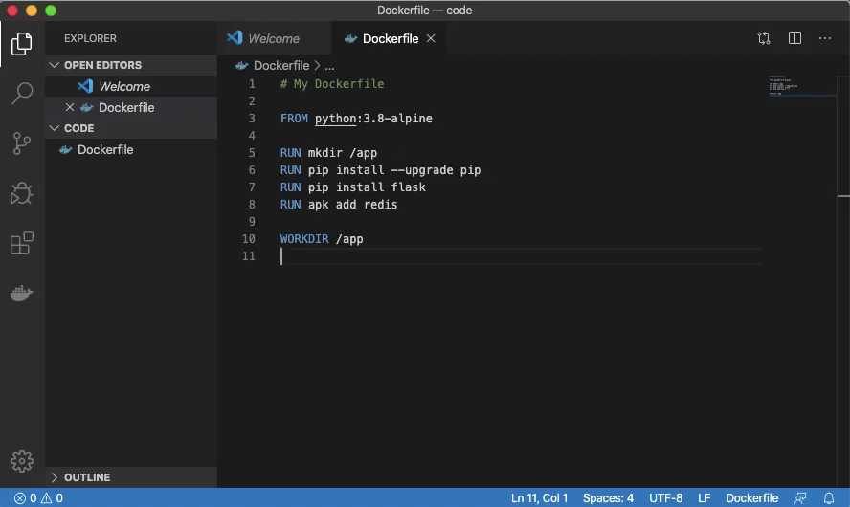
Notes:
// TODO

Slide 32
The EXPOSE Instruction
Informs Docker that the container listens on a specific port at runtime
Does NOT actually publish the port, functions as documentation
Info from the image builder to the person who runs the container
EXPOSE 8080
EXPOSE instruction
port (TCP is the default)
EXPOSE 8080/tcp
EXPOSE 8080/udp
Notes:
// TODO

Slide 33
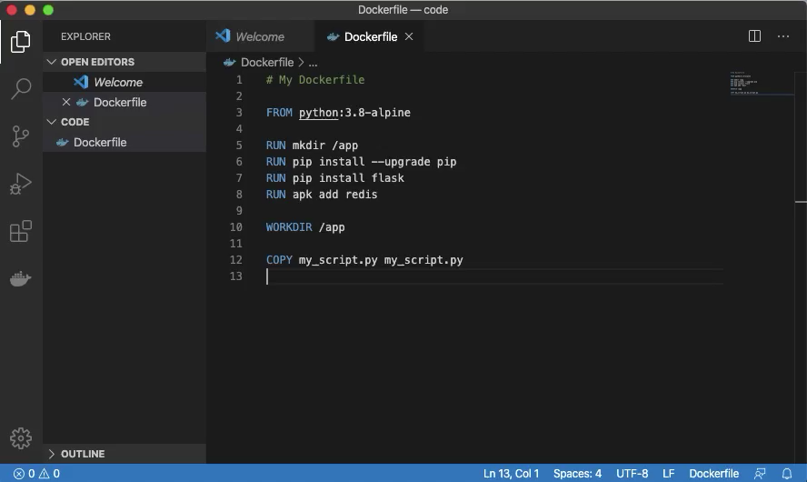
Notes:
// TODO

Slide 34
The LABEL Instruction
Adds metadata to the image
Denoted in key-value pairs (maintainer="Kris Miller")
Dockerfiles support single and multi-line LABEL instructions
LABEL maintainer="Kris Miller <kris.miller@acme.com>"
LABEL instruction
key
value
LABEL version="1.0"
LABEL description= "Web Application Image"
Notes:
// TODO

Slide 35
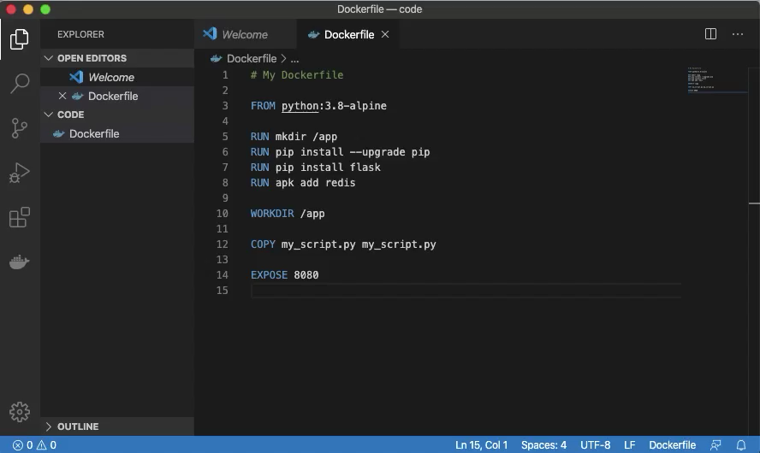
Notes:
// TODO

Slide 36
The CMD Instruction
Specifies the executable for containers run at startup (sh, flask, etc.)
The Final Dockerfile instruction
Only one CMD instruction allowed
CMD sh
CMD instruction
executable
CMD echo "Hello World"
CMD flask run --host=0.0.0.0 --port=5000
Notes:
// TODO

Slide 37
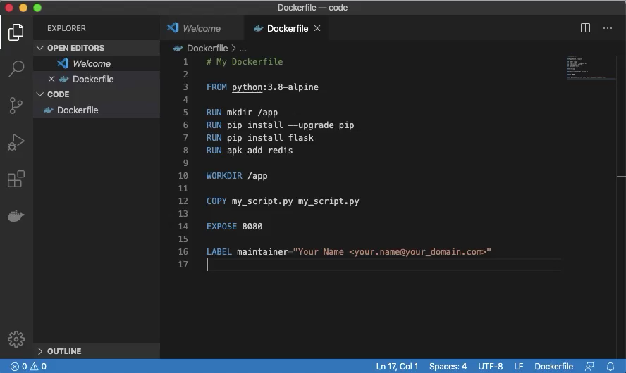
Notes:
// TODO

Slide 38
Build Docker Images
You have a complete Dockerfile, let’s do something with it!
Open your terminal and switch to the directory with your Dockerfile
For example, cd ~/code
Create a Docker Image with either of these commands:
docker build -t my_image .
docker image build -t my_image .
Don’t forget the dot!
Notes:
// TODO

Slide 39
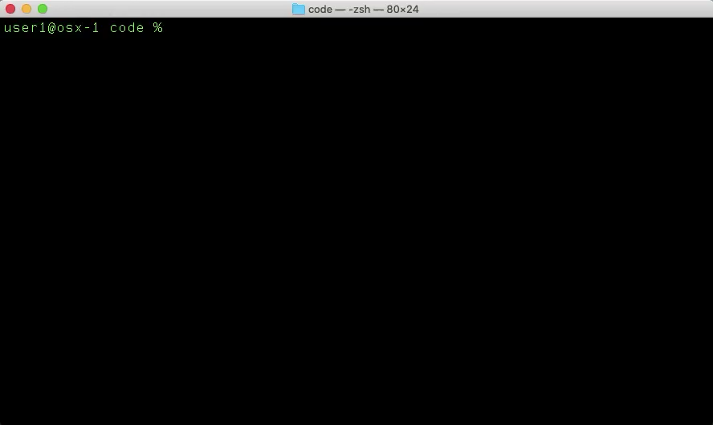
Notes:
// TODO

Slide 40
Remove Docker Images
List your Docker Images with the terminal command:
docker image ls
Remove your Docker Image with either of these commands:
docker image rm my_image
docker image rm image_id (docker image rm 6d37630d7e9b)
In some cases, you need to use the -f option to force removal:
docker image rm -f my_image
List your Docker Images again to confirm the delete:
docker image ls
Notes:
// TODO

Slide 41

Notes:
// TODO

Slide 42
Docker Image Challenge
Rebuild your Docker Image
What is different between the first and second builds?
Notes:
// TODO

Slide 43

Notes:
// TODO

Slide 44
Part IV
Run Docker Containers
Notes:
// TODO

Slide 45
Docker Containers
Ephemeral instances of Docker Images
List your Docker Containers with the terminal command:
docker container ls -a
Notes:
// TODO

Slide 46
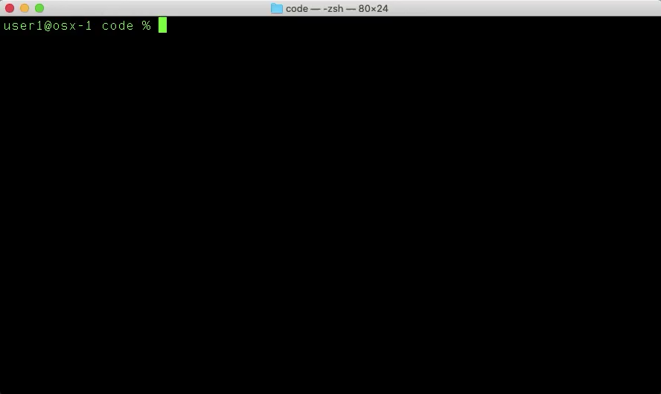
Notes:
// TODO

Slide 47
Docker Container Command Flags
Several command flags are necessary to run a Docker Container
docker container run [FLAGS] image_name
-i – interactive mode
-t – create a pseudo-TTY session
--name my_container – assign a name to the container
-v host_dir:container_dir – mount a volume to the container
-p host_port:container_port – publish a container port to the host
-d – run the container in the background (detached mode)
--rm – automatically remove the container on exit
image_name my_image – specify the source image name for the container
Notes:
// TODO

Slide 48
Docker Container Command Examples
docker container run -it --name my_cont my_image
Create a Container named my_cont from the my_image Image
Use interactive mode with a pseudo-TTY session
docker container run -itv /code:/app --name my_cont my_image
Mount the local folder /code the container folder /app
docker container run -dp 8443:443 --name --rm my_cont my_image
Run the Container in background (detached) mode
Forward the local (host) TCP port 8443 to the container TCP port 443
Remove the container when it stops
Notes:
// TODO

Slide 49
Create a Docker Container
Use your Docker Image to create a Docker Container
docker container run -it --name my_cont my_image
Exit interactive terminal mode with the escape key sequence
control + p + q
List your Docker Containers
docker container ls -a
Notes:
// TODO

Slide 50
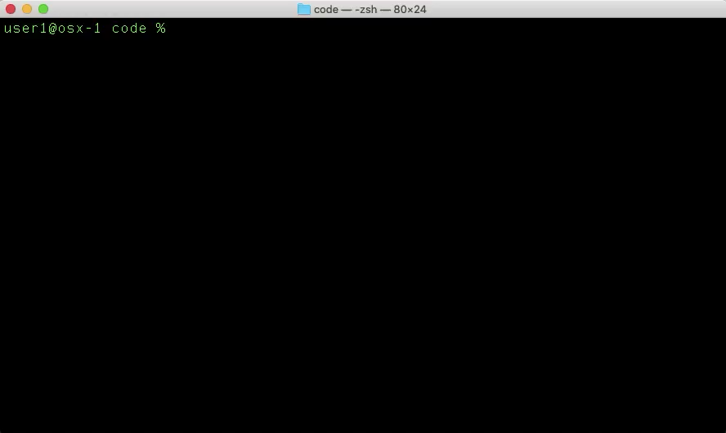
Notes:
// TODO

Slide 51
Attach to a Running Container
List your Docker Containers
docker container ls -a
Attach to your running container
docker container attach my_cont
Run the Python script in your container
ls -l
python my_script.py
Notes:
// TODO

Slide 52

Notes:
// TODO

Slide 53
Stop a Running Container
List your Docker Containers
docker container ls -a
Stop your running container
docker container stop my_cont
List your Docker Containers again, to observe the new container state
docker container ls -a
Notes:
// TODO

Slide 54
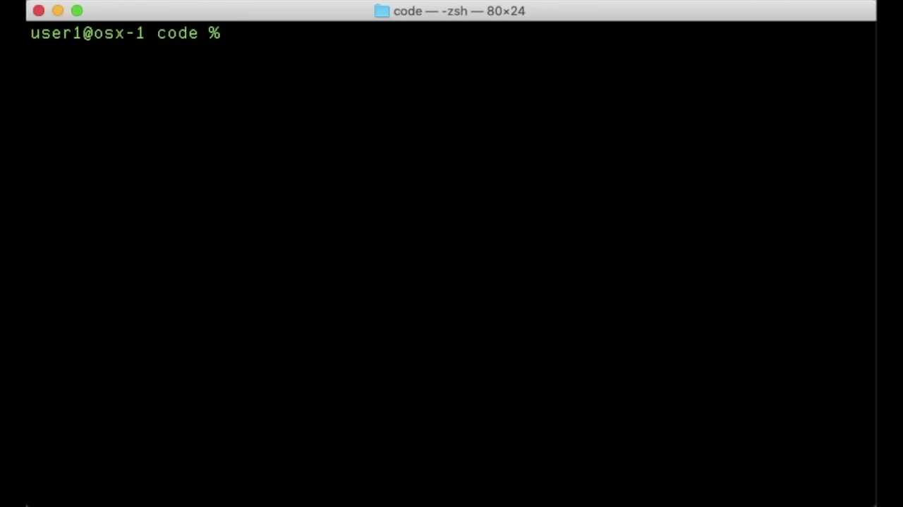
Notes:
// TODO

Slide 55
Start a Stopped Container
List your Docker Containers
docker container ls -a
Start your running container
docker container start my_cont
List your Docker Containers again, to observe the new container state
docker container ls -a
Notes:
// TODO

Slide 56

Notes:
// TODO

Slide 57
Remove a Container
List your Docker Containers
docker container ls -a
Stop your running container
docker container stop my_cont
Remove your stopped container
docker container rm my_cont
List your Docker Containers again, to see the result of the removal
docker container ls -a
Notes:
// TODO

Slide 58
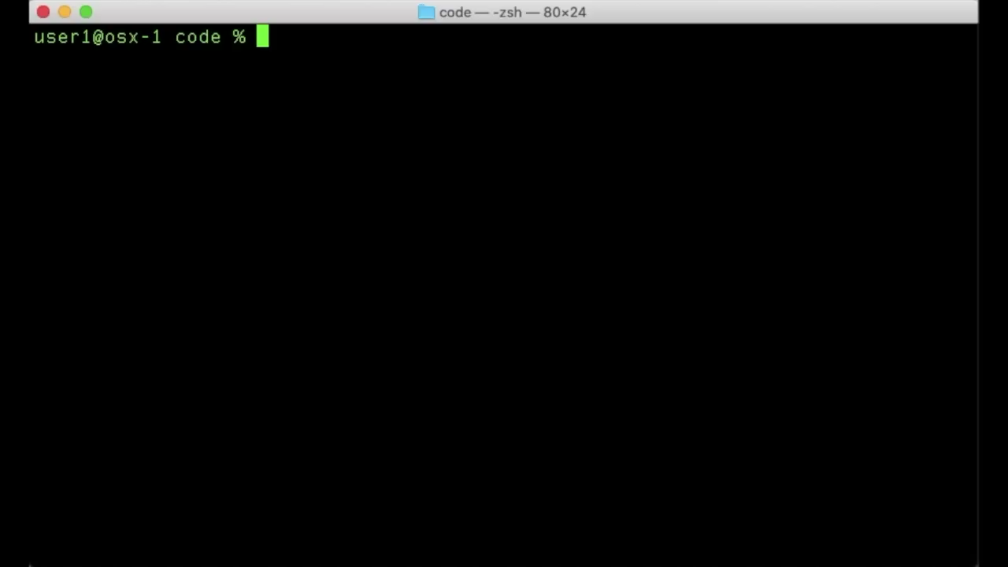
Notes:
// TODO

Slide 59
Create a Docker Container With a Mapped Volume
Create a new directory and file on your host computer
mkdir my_dir
cd my_dir
vi my_file
Press i to insert text, type some text, press escape
Type :x and press Enter/Return to save and exit
Use your Docker Image to create a Docker Container
docker container run -itv $PWD:/app/files --name my_cont my_image
Observe the mapped volume in your Container
ls -l
cd files
cat my_file
Notes:
// TODO

Slide 60

Notes:
// TODO

Slide 61
Part V
Docker Quick Hits
Notes:
// TODO

Slide 62
Share Docker Images
Notes:
// TODO

Slide 63
Notes:
// TODO

Slide 64
Cleaning Up
docker system df [-v]
Dangling images (<none> repository and tag names)
docker system info
docker system prune
docker image/container prune
Notes:
// TODO

Slide 66
Docker Compose
A quick overview

Slide 68
References
Reference 1
Reference 2
Reference 3
Reference 4

Slide 69
Notes:
// TODO

